Slide 1
Sailing Safety
Selected topics on Safe sailing
TASS Education Class
By Mark Shield
5 May 2019

Slide 2
Topics Covered
Personal data
Think about Safety
National Boating Week
Boating Fatalities
Boating Injuries
PFDs
Skipper, Crew Responsibilities
Before we leave the doc
Pre-Underway Brief
Safety Underway
Situational Awareness
ICE
Unexpected Event
USCG/USCGA
Communicating with the USCG
Types of radio messages
Communication Protocol
COB
Suddenly in Command
Distress Signals
Seamanship

Slide 3
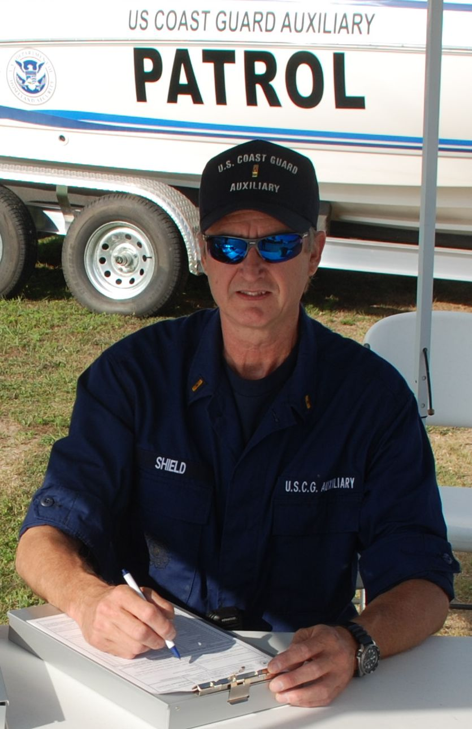
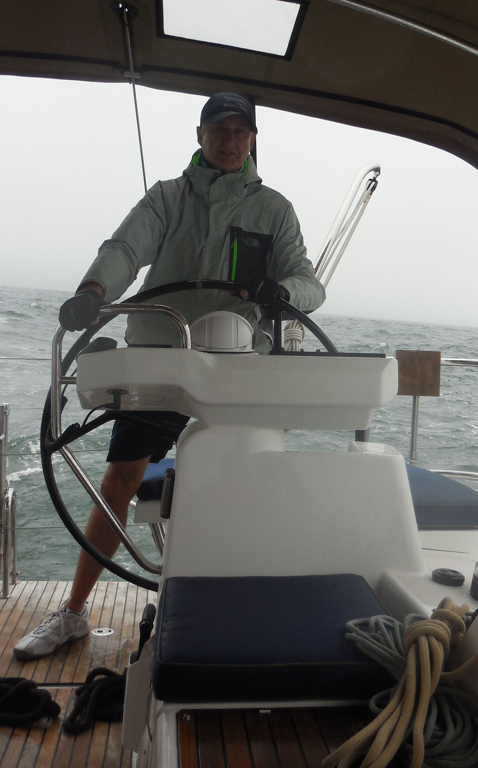
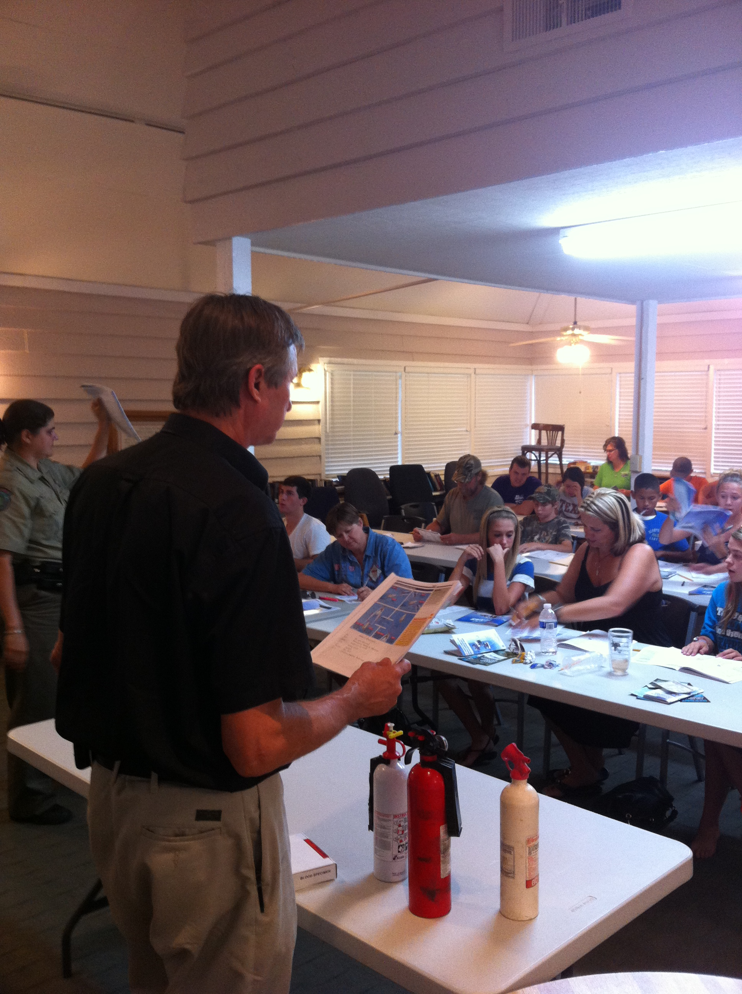
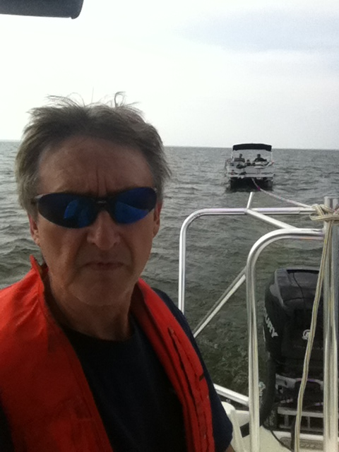
Why Me?
Avid Sailor ASA 101 – 106, 114, 118
Owned numerous sailboats
Cape Area VFD – Marine SAR Skipper
Retired US Coast Guard Auxiliary
Boat Crew
Coxswain
PWO
Vessel Examiner
AUXOP
State of Texas Boating Safety Instructor

Slide 4
Sailing and safety?
Sailing environment is dynamic
Events happen
Acknowledge the Risks
Put Safety first and do your upmost to ensure it
Prepare for and train for the unexpected
USCG and their attitude toward safety:
“Overshadowing the individual safety rules is forehandedness. All hands must anticipate potential problems and take action to avoid them. Safety-consciousness, imparted in some measure by shipboard evolutions, will grow as an attitude in every member of the crew.”
This is a good blueprint – think ahead, train and think safety!

Slide 5
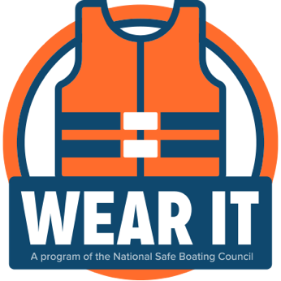
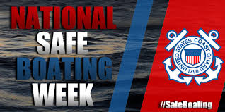
National Safe Boating Week 18 – 24 May
Promoting boating and life jacket safety to boaters everywhere
A program of the National Safe Boating Council
“Saved by the jacket” - video

Slide 6
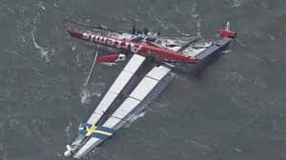
Typical Boating Fatalities - 2017
4,291 accidents, 658 deaths, 2,629 injuries
$46 million of damage to property
76% of accident victims drowned, of those 84% we not wearing PFD’s
Alcohol was a factor in 19% of deaths
Top 5 primary factors contributing to boating accidents
Operator Inattention
Improper lookout
Operator inexperience
Machinery failure
Alcohol
http://www.uscgboating.org/library/accident-statistics/Recreational-Boating-Statistics-2017.pdf

Slide 7
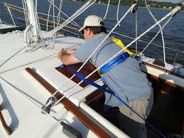
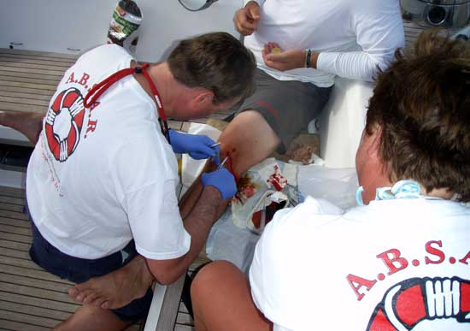
Location, Location, Location
Statistically, most injuries on a keel boat occur in the cockpit because it is where people spend most of their time. On racing yachts, the most common place for an injury was the foredeck. Andrew Nathanson, MD
https://www.ybw.com/expert-advice/common-sailing-injuries-and-how-to-avoid-them-42321

Slide 8
Causes of Common Sailing Injuries

Slide 9
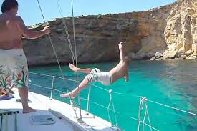
No. 1 Cause – Tripping or Falling
Tripping and falling are the most common injuries while sailing
Accounting for 30% of injuries
Results are Fractures, head injuries, severe bruises
Falls down companion ways
Falls on deck
Falls overboard
At Dock
While underway

Slide 10
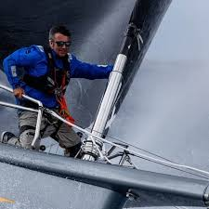
Prevention - Tripping or Falling
“One hand for you, one hand for the ship”
The ergonomics of boats can also be improved
Reducing “trip hazards” on board
Improved footwear
Better anti-skid deck surfaces
Less clutter and more ergonomic deck layouts

Slide 11
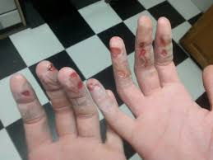
No. 2 Cause – Line Handling
Be careful when handling sheets
Finger and hand injuries are some of the most common sailing injuries which result in sailors seeking emergency treatment
Accounted for 28% of injuries
Can all be caused by incorrectly releasing line under tension
When trimming, make sure fingers are clear
Always pull straight up and make sure the sheet is not wrapped around anything or anyone
Always wear gloves

Slide 12
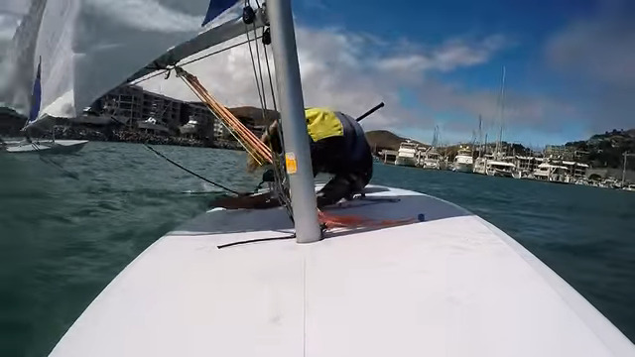
No. 3 Cause – Hit by Equipment
Being hit by an object is responsible for around 21% of all injuries
Most often occur during tacks and jibes, especially in high winds
Sailors, who are in the “wrong place at the wrong time”
Heavy weather, fatigue and equipment failure are also contributing factors
Be careful when crossing from the low to high side under the boom
Make sure there is good communication and awareness before any maneuver

Slide 15
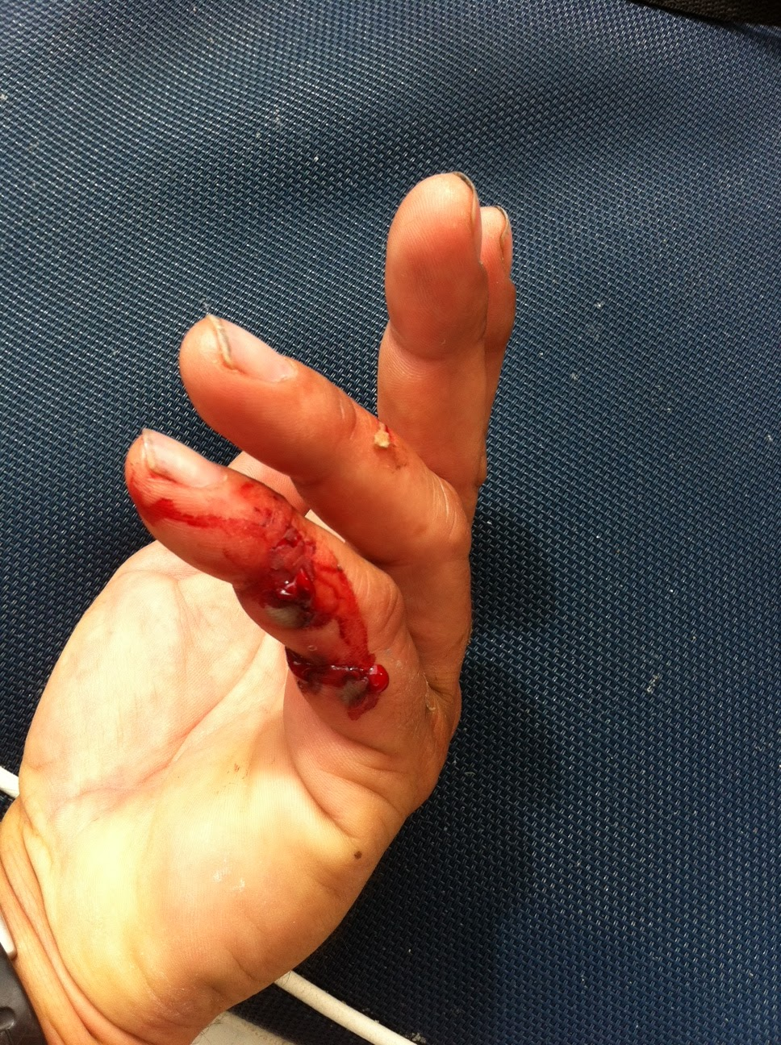
No. 4 Cause – The Winch
Winch use was the fourth most common mechanism of injury on a keel boat
Responsible for around 8% of injuries
Ergonomics of Winch handling
Tough on your back and on your knees and thighs
Strength training and improved technique are two ways to minimize this

Slide 16
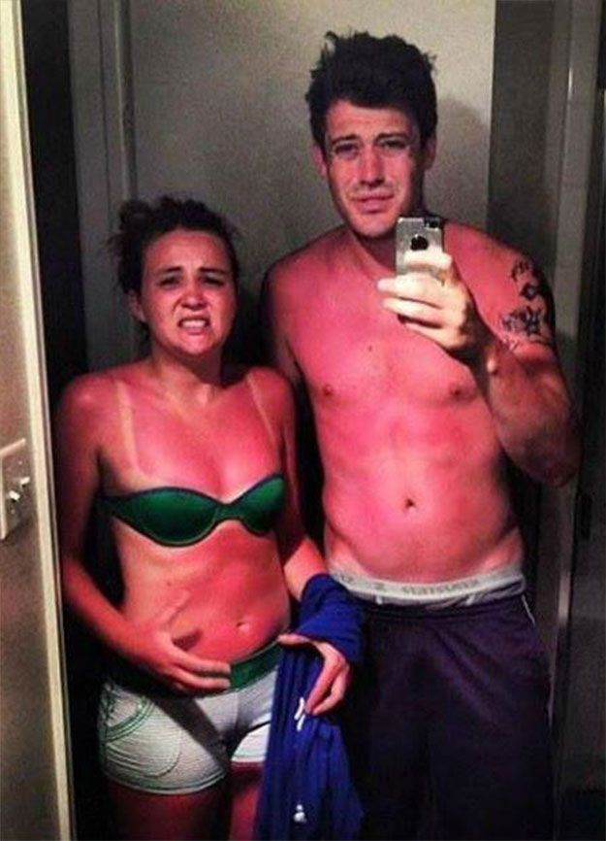
Protect yourself from the sun
Sailors should consider skin cancer risks
Think about sunburn prevention
16% of sailors reported having suffered from sunburn while sailing in the preceding 12 months
The use of sunscreen is low, especially among sailors aged 30 or under.

Slide 17
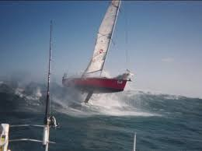
Sailing conditions are dynamic. Your safety, and that of your crewmates, depends on your good physical health, mental awareness and planning.

Slide 18
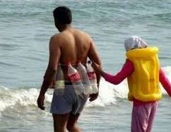
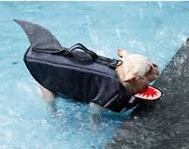
PFD – Personal Flotation Device
One of the top reasons for fatal injuries is being swept overboard
Wearing a life jacket nearly doubles your chances of survival
Wear a life jacket and/or harness when out on the water
Especially when reefing a main or jibing
Always at night and while sailing in heavy weather

Slide 19
PFD’s
Type 1 Currently, there aren't any Coast Guard approved Type I inflatable PFD's available to the general public.
Type 2 Inland day cruising, fishing and sailing. Good for boating in light craft.
Type 3 Supervised activities, such as sailing regattas, dinghy races, water skiing, etc.
Type 4 Throwable
Type 5 Restricted to the special, auto-inflation use for which each is designed

Slide 21
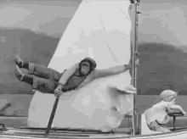
Let’s go Sailing

Slide 22
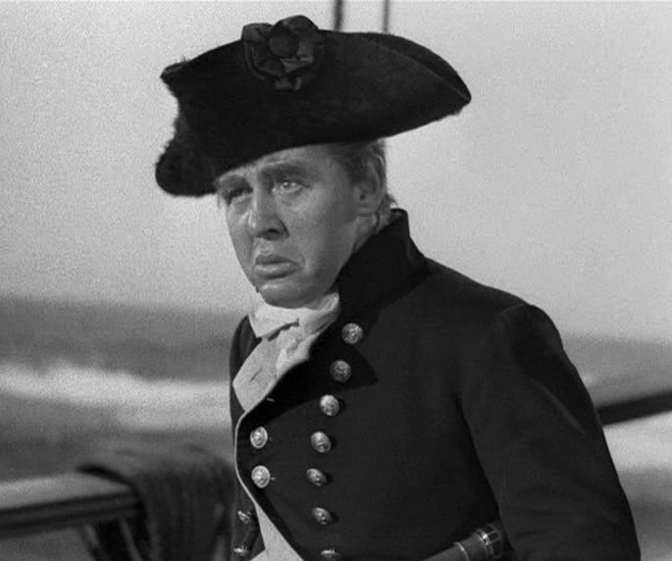
Skipper Responsibilities
The skipper is responsible for the safety of his crew and vessel
Proper management of all Vessel Operations
Knows and follows regulations and maritime laws
Trip Planning
Thorough pre-trip boat checkout
Crew Communication – keep crew informed
Pre-Underway Brief
Shipboard Harmony

Slide 23
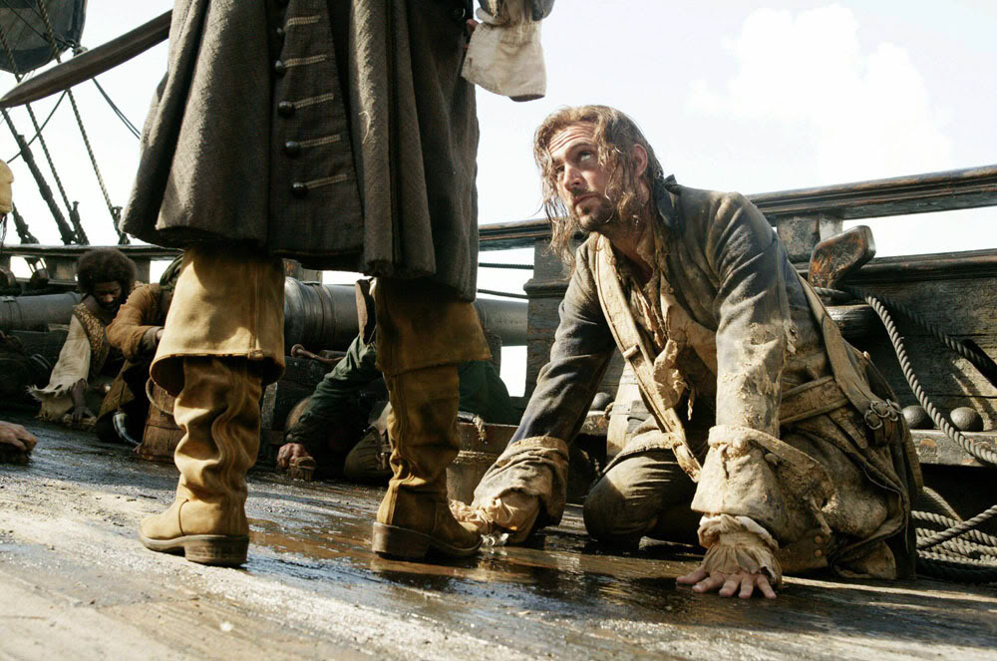
Crew Responsibilities
To listen to and act on the skippers commands
To act in a safe manner while aboard
Knowing where all safety equipment is and how to use it
Telling the skipper of any health or mobility issues
Telling the skipper if you can swim
Asking questions if unclear
Sharing the work
Controlling and keeping their space tidy and safe

Slide 24
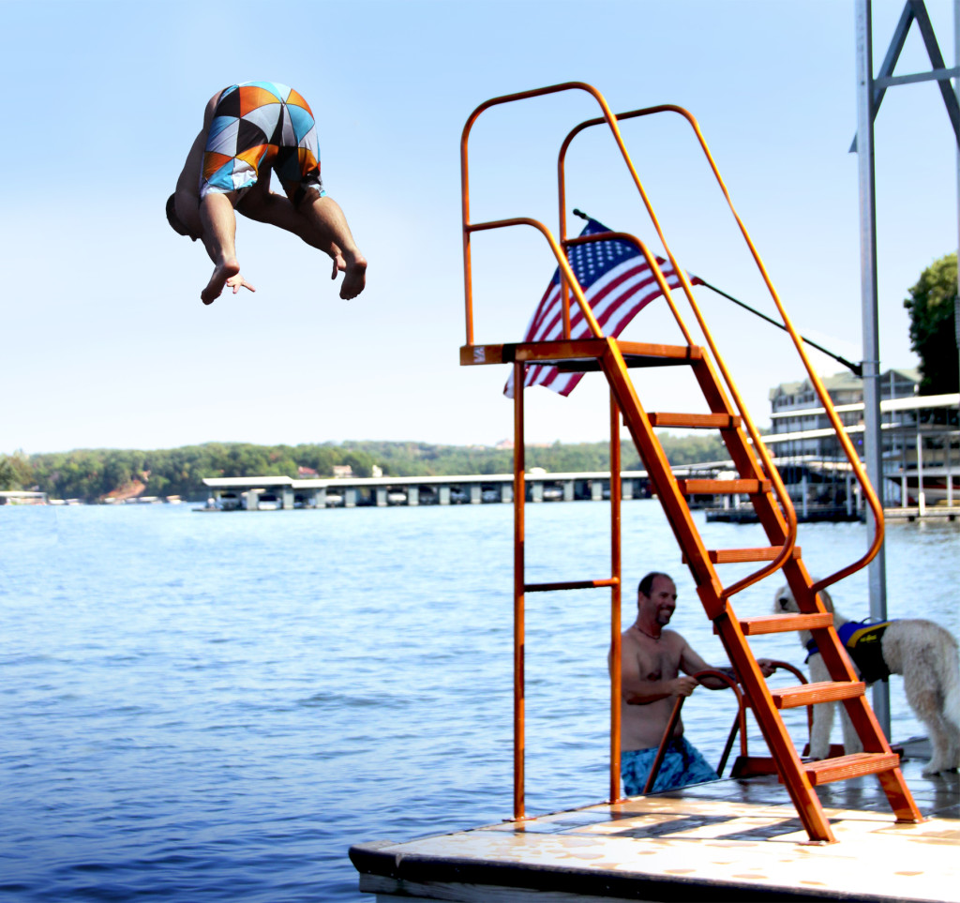
Before We Leave the Doc
Conduct a Pre-underway Brief with checkoff-list
Have crew sign Release of Liability Document
Confirm the boat is seaworthy
Confirm crew is competent to successfully perform their tasks
Discuss safety issues, common injuries, wearing of jewelry
Discuss Crew coordination and communication
Perform Risk assessment
Perform Weather assessment

Slide 25
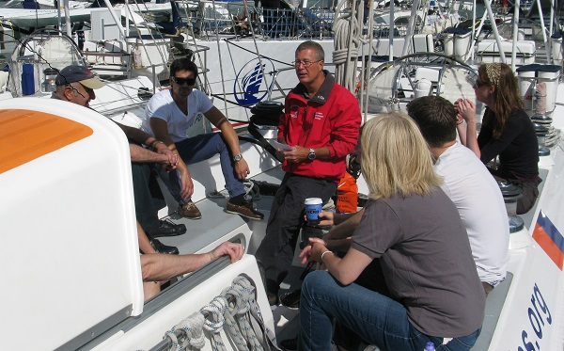
Pre-Underway Brief 1
Engage the crew – give them key information in the first 3 minutes
Announce Skipper and Second in Command
Give Crew assignments
Discuss and display the location of:
PFDs
Fire extinguishers
VHF Radio and frequencies to use
First Aid and Trauma kit
Life ring

Slide 26
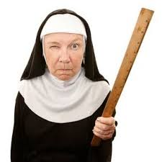
Pre-Underway Brief 2
Any medical expertise on board?
Float Plan - Incident Contact information
Any known safety issues and mitigation
General Emergency Procedures
COB, Boat Collision, Fire
Secure loose gear
Discuss plan for departure
Safety is everyone's responsibility

Slide 27
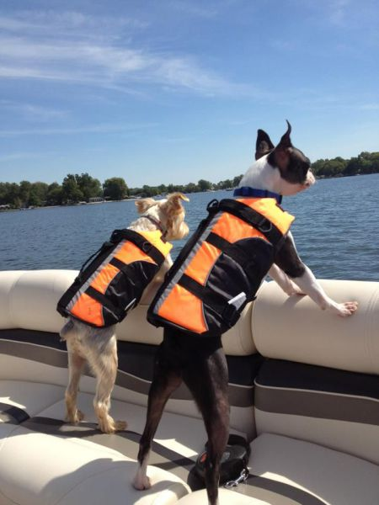
Safety Underway
No one unties a line without direction of the skipper
When leaving dock, all lines to be doubled, everyone on board when departing
No one pushes a boat away from the dock or jumps onto a moving boat
Arms, legs, fingers and toes are not to be used to prevent damage to boat
Keep all hands and fingers away from winches
Keep vigilant regarding the swinging of the boom – inadvertent jibe
Everyone is a lookout!
Everyone has a say in the overall safety of the voyage
Mention any issue you feel may adversely affect crew or boat safety
Smell of fuel or exhaust fumes

Slide 28
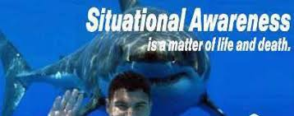
Situational Awareness
Know your location
Know what’s going on around you
Know and monitor the weather
Anticipate emergencies
Be aware of medical problems
Know the location of emergency equipment
Be able to use a marine radio on board and give your location
Be able to describe your boat!

Slide 29
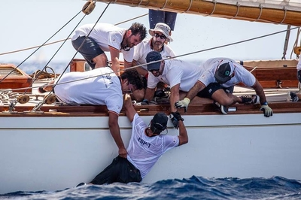
Unexpected Event
Accidents follow a pattern
Something triggers an unexpected event
The event causes distraction
Distraction contributes to lose of control or lose of Situational Awareness
Distraction causes escalation of original event or introduces new, unanticipated events
Stay focused on your primary tasks, but be aware of other potential problems around you

Slide 30
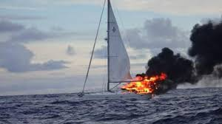
ICE – In Case of Emergency

Slide 31
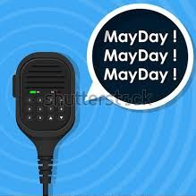
What is an Emergency
Life is in imminent danger
Ship is in danger of sinking
Ship is a Hazard to other vessels
The USCG is always ready to render aid to boaters facing extreme and imminent danger and their help depends upon:
Current deployment of SAR resources
Nature of your emergency
Location
Current and future weather conditions
Your ability to help yourself
The ability and proximity of other boaters

Slide 32
U. S. Department of Homeland Security United States Coast Guard
https://www.uscg.mil/home/
The Coast Guard protects America’s economic, national and border security and has Six Operational Mission Programs
Maritime Law Enforcement
Maritime Response
Maritime Prevention
Marine Transportation System Management
Maritime Security Operations
Defense Operations

Slide 33
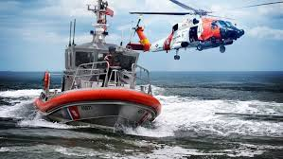
On an average day, the Coast Guard:
Conducts 45 search and rescue cases
saves 10 lives
saves over $1.2M in property
seizes 874 pounds of cocaine and 214 pounds of marijuana
conducts 57 waterborne patrols of critical maritime infrastructure
interdicts 17 illegal migrants
escorts 5 high-capacity passenger vessels
conducts 24 security boarding’s in and around U.S. ports
screens 360 merchant vessels for potential security threats prior to arrival in U.S. ports

Slide 34
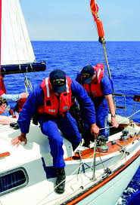
USCG - continued
conducts 14 fisheries conservation boarding’s
services 82 buoys and fixed aids to navigation
investigates 35 pollution incidents
completes 26 safety examinations on foreign vessels
conducts 105 marine inspections
investigates 14 marine casualties involving commercial vessels
facilitates movement of $8.7B worth of goods and commodities through the Nation’s Maritime Transportation System.

Slide 35
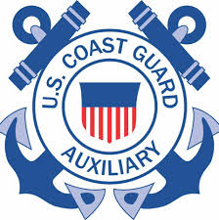
United States Coast Guard Auxiliary -DHS
http://www.cgaux.org/
Semper Paratus – “Always Ready” since 1939
Uniformed force contributing to the safety and security of our coasts and waterways
26,000 members serving in 825 local units in 16 Districts (We are District 8cr)
3.8 million hours in support of United States Coast Guard
In the Classroom at the Ramp and Pier
Operating 1,800 vessels

Slide 36
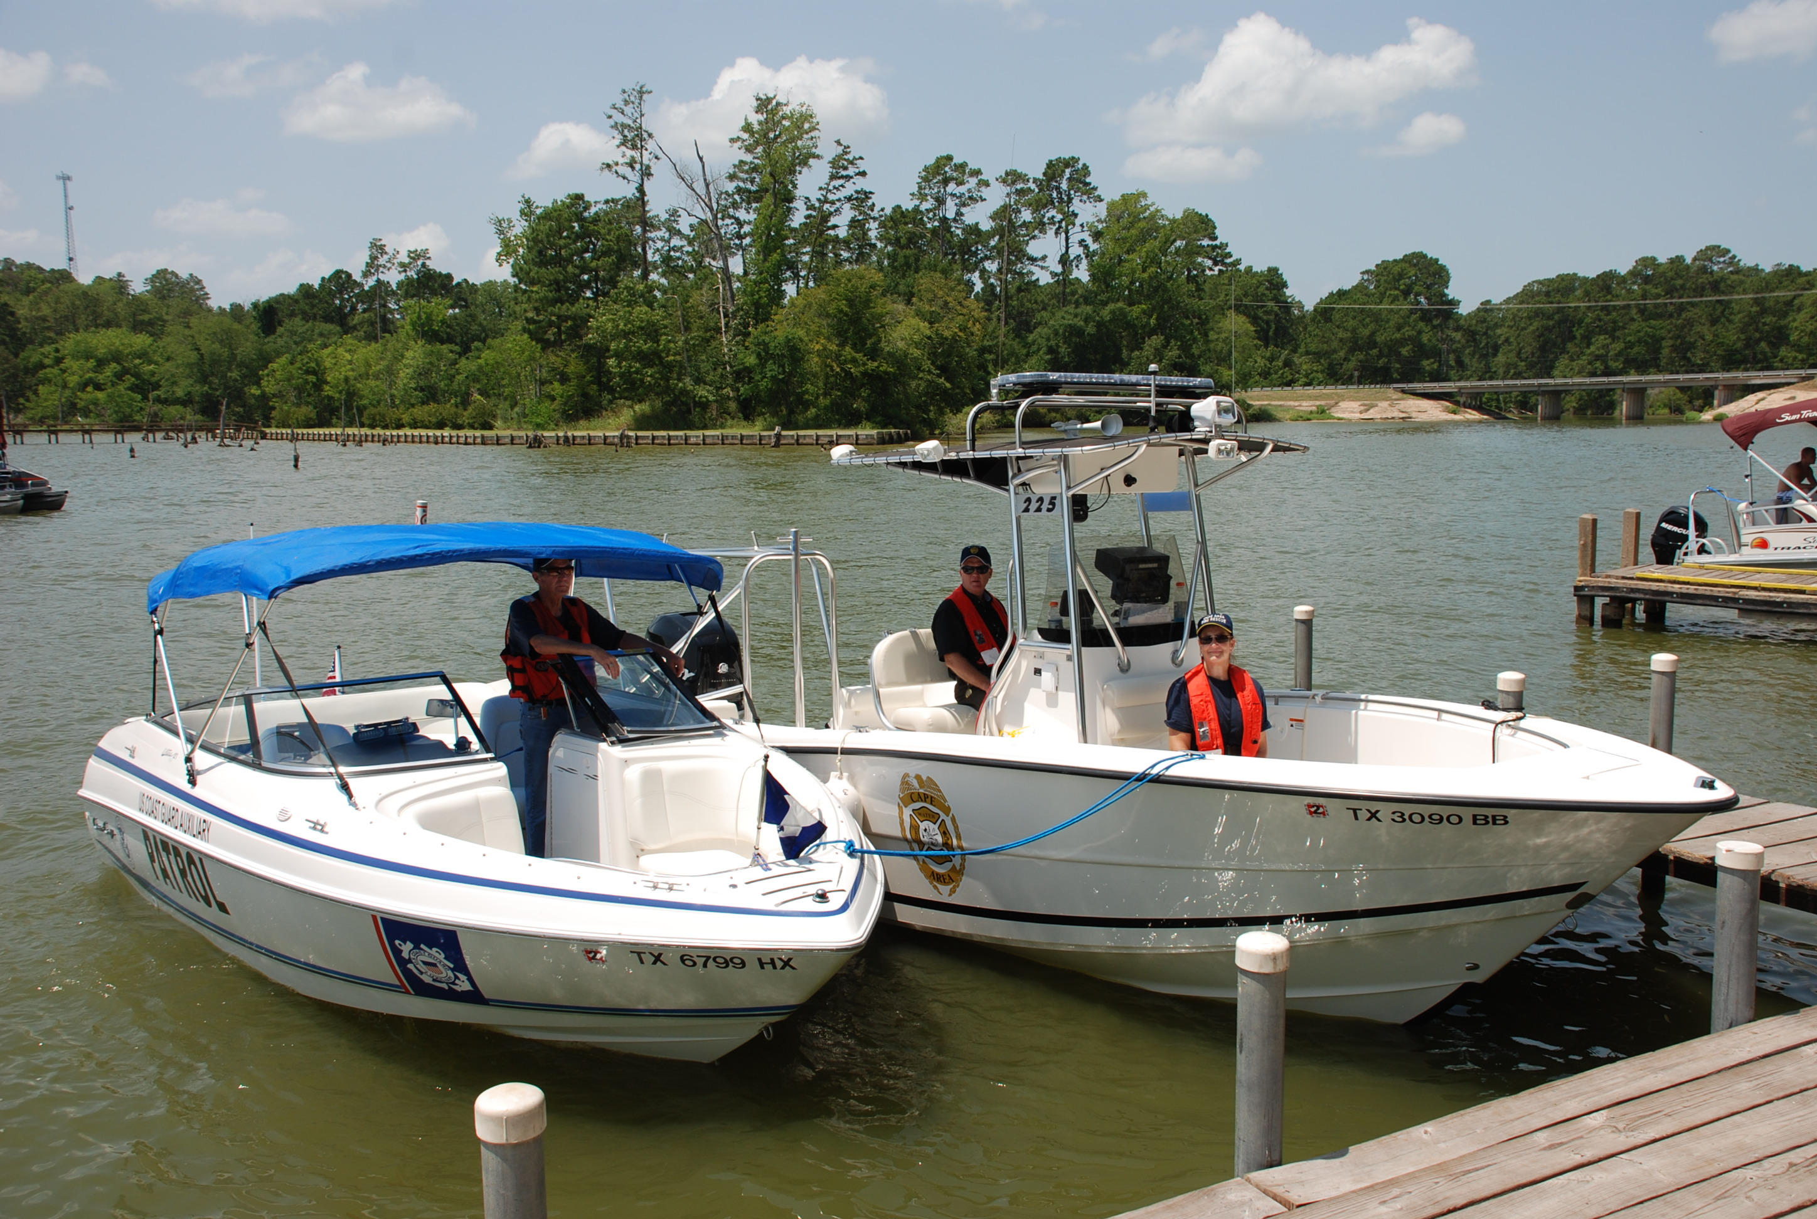
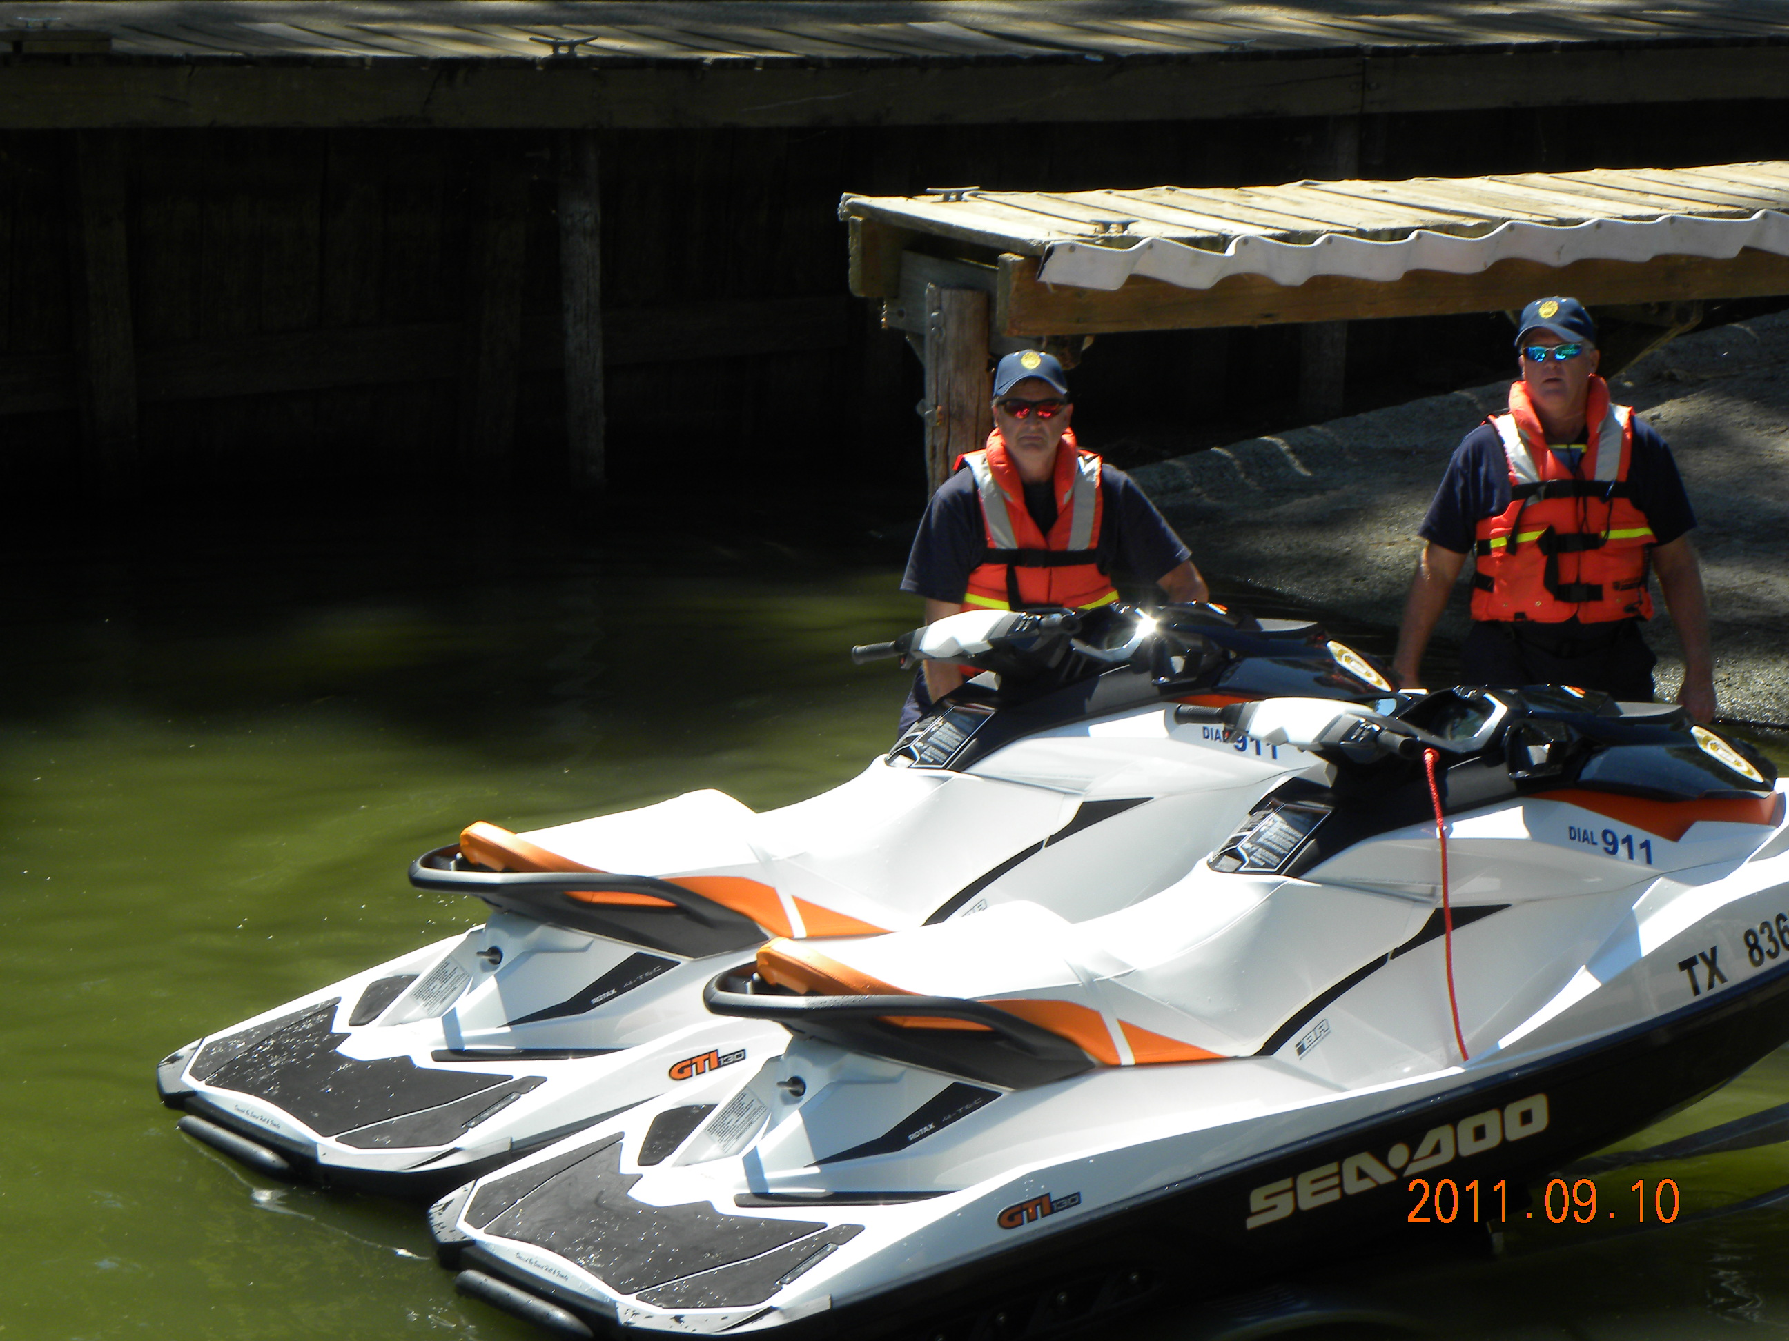
United States Coast Guard Auxiliary -DHS
160 Aircraft
1,400 Radio Facilities
Provide Boating Safety Education
Vessel Safety Checks
Recreational Boating Safety Information
No Law Enforcement Authority
Incident Command Protocol

Slide 37
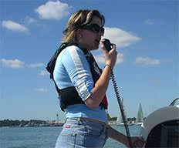
Types of Communications with the Coast Guard
Via Phone or Radio
Mayday (Distress) - internationally recognized distress call that is used as preface in VHF radio transmissions only in situations in which there is an immediate danger of loss of life or the vessel itself
Pan (Urgency) - is the international urgency signal that is used as a preface to a VHF transmission when the safety of a person or the boat is in serious jeopardy but no immediate danger exists
Sécurité (Safety) - safety signal used as a preface to announce a navigation safety message.

Slide 38
Protocol for Emergency Assistance
VHF-FM Channel 16 (156.8 MHz) or 2182 kHz MF/SSB
Mayday, Mayday, Mayday.
WHO: This is…Your Boat Name
WHERE: We are located at…Accurate location – GPS location, distance/bearing from observable landmark
WHAT: We are experiencing…Nature of Emergency
KIND; We Require…What kind of help do you need
NUMBER: Aboard are…State number of POB’s and the condition of any injured.
SEAWORTHYNESS: Condition of boat is as follows…
DESCRIPTION: Our boat is…boat type, length, hull and trim color, Bimini color if you have one
SCHEDULE: I will be monitoring channel 16 every …minutes…
This is Your boat name
“Over:

Slide 41
Emergency Assistance contd.
Be prepared to give other information as requested. You will usually be asked if you have a cell phone available in case they lose radio communication with you.
Speak slowly, clearly, and enunciate your words. Language can become garbled over the radio making it very hard to understand. Keep your body between any noise source (engine, wind, etc) and the microphone. Telling them the nature of the emergency helps to alert the proper agency.
All lines, anchors out of water, clear boat for boarding, prepare sliding bridal on distressed boat.
You can help improve response time by upgrading to a Marine-Band VHF-FM radio equipped with digital selective calling (DSC).

Slide 42
COB Procedure (Crew Overboard)

Slide 43
COB Procedure (Crew Overboard)
Alert Skipper – Shout and Point
Mark COB on NAV Equipment
Throw the PIW a flotation device
Keep the person in view - Pointer assigned
Recovery/Pickup person assigned
Reduce speed – check traffic around you
Communicate with crew – assign tasks
No sharp or unexpected turns

Slide 44
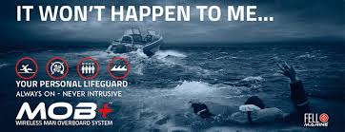
COB Procedure (Crew Overboard) Cont.
No sudden acceleration or deceleration without warning
Approach from downwind
Plan haul out procedure
Stop Engine
No boat hook, use bowline and line or web strap - have on board and ready
Etrier and/or loop made prior to emergency

Slide 45
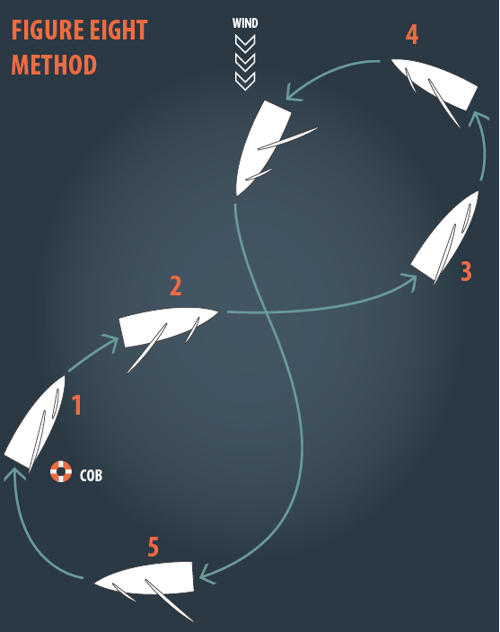
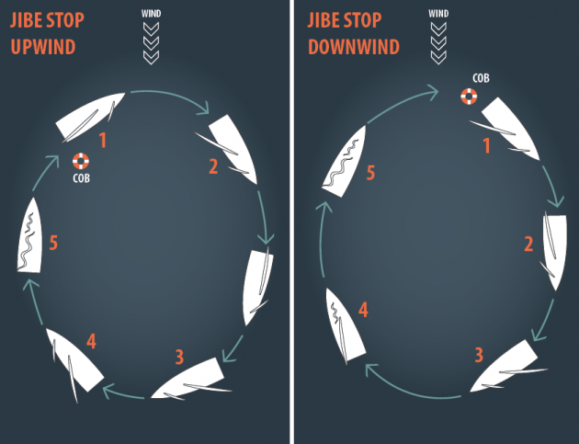
COB Procedure (Crew Overboard) Cont.

Slide 46
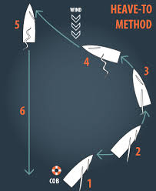
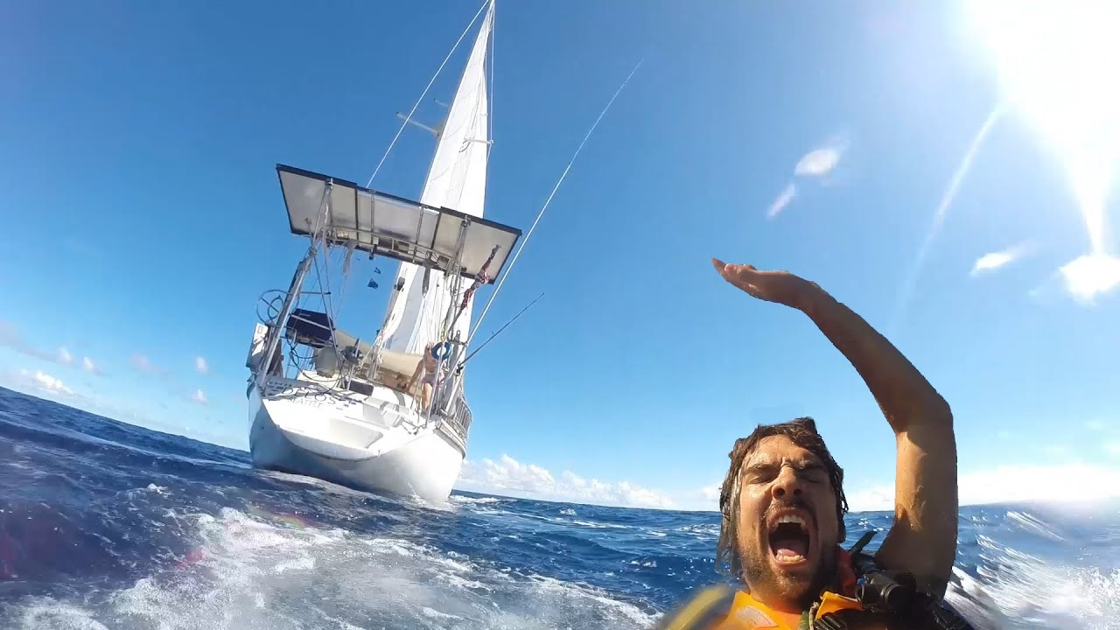
Another COB method

Slide 48
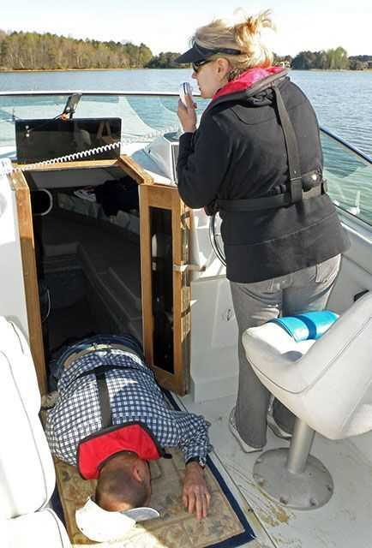
Skipper is incapacitated, YOU are in command!
Assess what happened
Environmental Emergency ?
Mechanical problem?
Medical Emergency?
How Urgent is the situation?
Potential loss of life or the boat?
Crew in danger or in panic?
Situation likely to deteriorate?
Am I alone or have onboard help?
What are my resources?
Stay focused

Slide 49
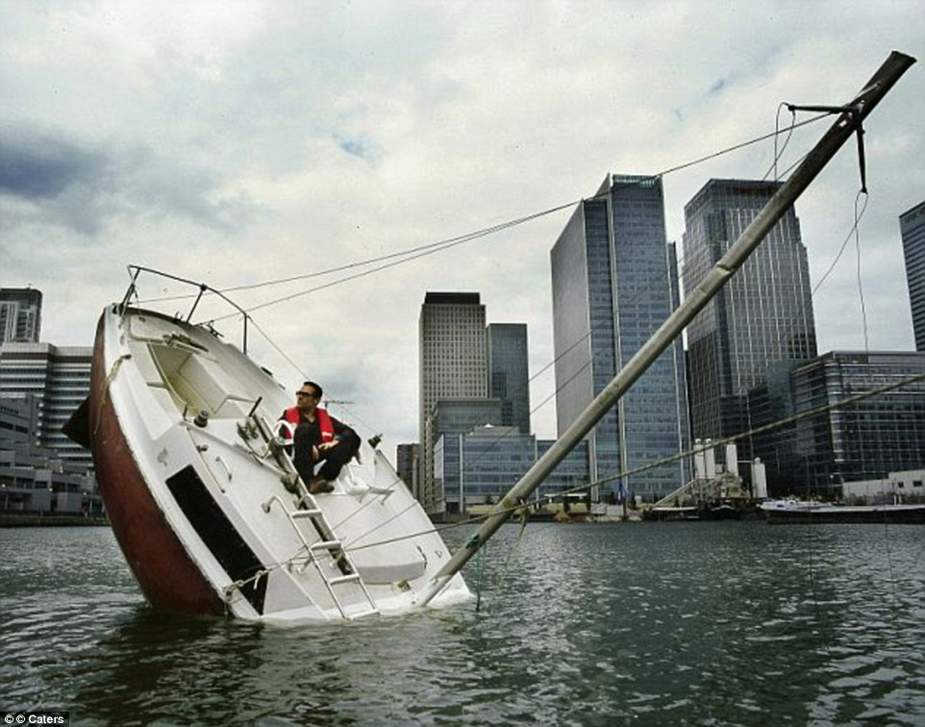
SIC contd.
Take charge
Everyone has a PFD on
Clearly communicate what needs to be done
Be patient and courteous of others
Do I need assistance? Distress Radio Transmission?
Other boaters
Local Sheriff Department
Coast Guard
911
Stabilize the Situation
Know your location
Be aware of other boats or traffic
Post a lookout
Calmly work the incident

Slide 50
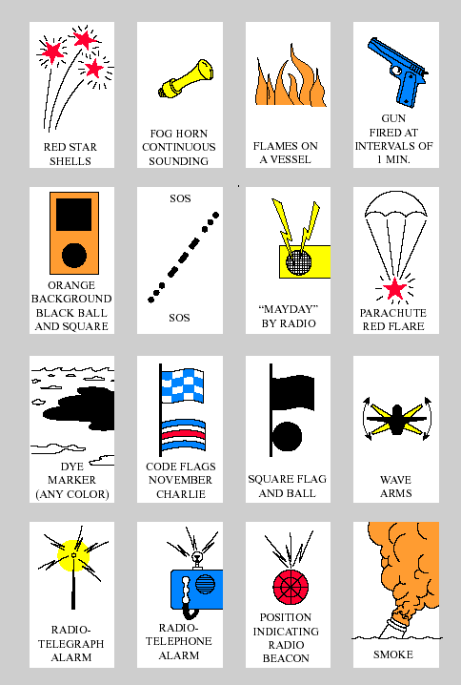

Slide 51
The knowledge and skill pertaining to the operation, navigation, management, safety, and maintenance of a ship
Safety is a key component in sailing evolutions
It is equal parts experience and vigilance
Experience is the best teacher, it improves your seamanship
Good seamanship is characterized by a constant game of “what if…”
Remember - Safety comes first!

Slide 52
Handouts
Radio Frequencies
USCG radio procedures for 3 types of calls
Ditch Bag list
Online Resources List
Thank you For your time and interest!

